Slide 1
Statistics 367-1-4361 Bayesian Workflow
Opher Donchin

Slide 2
4.1 Bayesian workflow
The main trial and the side paths

Slide 3
Basic Bayesian processing
Data
Model
Sample
Posterior
Inference

Slide 4
A full workflow requires testing
Results can’t be trusted unless there is some way to check them
Data may be imprecise, invalid, and unreliable
A model may be incoherent or innapropriate
Samples may not actually reflect the posterior distribution
The posterior distribution may be incompatible with the data
Data
Model
Sample
Posterior
Inference

Slide 5
The full Bayesian workflow includes 3 tests
Does the model make sense
Is the sampling algorithm actually sampling the posterior
Does the posterior distribution fit the data
Sampling validity
Diagnostics
Data
Model
Sample
Posterior
Inference
Posterior predictive sampling
Prior predictive sampling
Model coherence
Model fit

Slide 6
4.2 Sampling challengs
Sampling arbitrary densities, rejection sampling

Slide 7
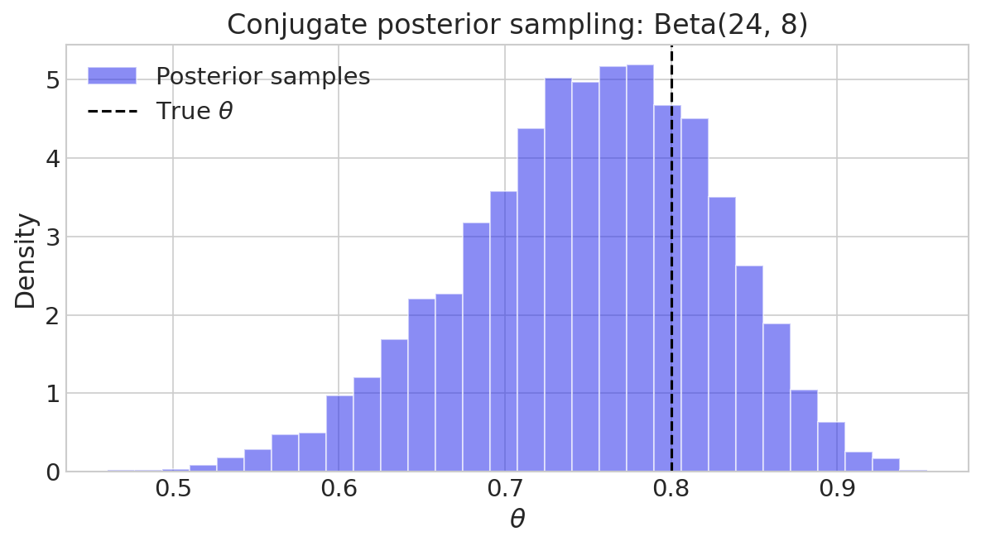
pm.sample() as a black box
For a beta-binomial model the posterior is also a Beta distribution
So pm.sample() could use a random number generator
Like the one in preliz
posterior_dist = pz.Beta(alpha=alpha_post, beta=beta_post)
posterior_samples = posterior_dist.rvs(5_000, random_state=123)

Slide 8
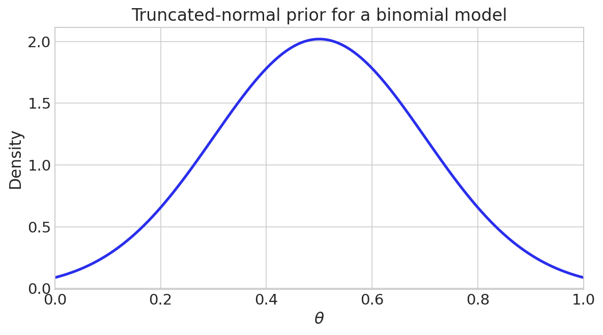
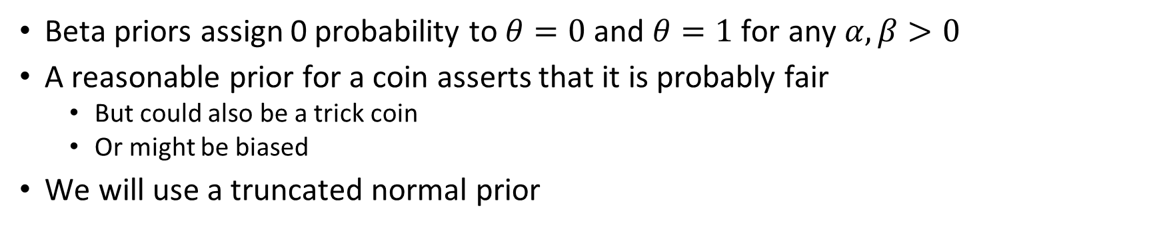
A non-beta prior for the coin flip model
Beta priors assign 0 probability to $θ=0$ and $θ=1$ for any $α,β>0$
A reasonable prior for a coin asserts that it is probably fair
But could also be a trick coin
Or might be biased
We will use a truncated normal prior
theta_prior_mu = 0.5
theta_prior_sigma = 0.2
lower = 0.0
upper = 1.0

Slide 9
PyMC has a truncated normal distribution
So we can use our prior in a PyMC model without difficutly
with pm.Model() as nonconjugate_binomial_model:
theta_nonbeta = pm.TruncatedNormal(
'theta',
mu=theta_prior_mu,
sigma=theta_prior_sigma,
lower=lower,
upper=upper,
)
y_nonbeta = pm.Bernoulli('y', p=theta_nonbeta, observed=data)

Slide 10
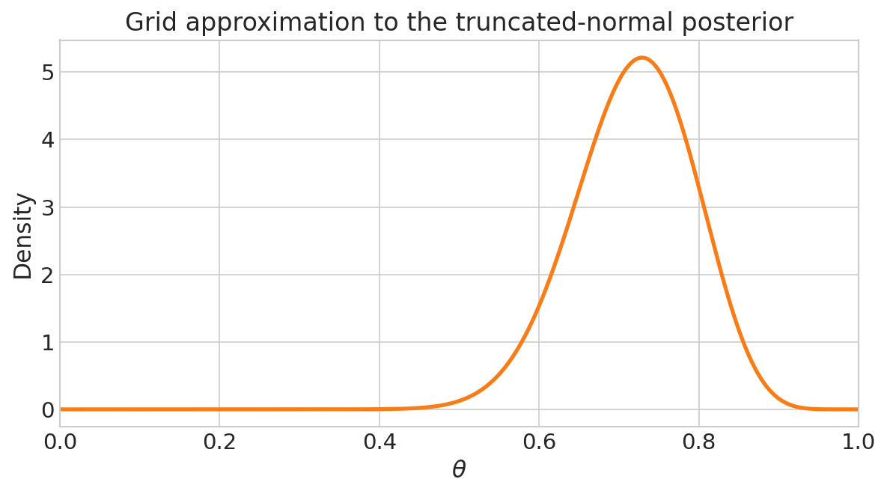
Preliz has no sampler for the posterior of this model
Posterior is proportional to likelihood times prior

Slide 11
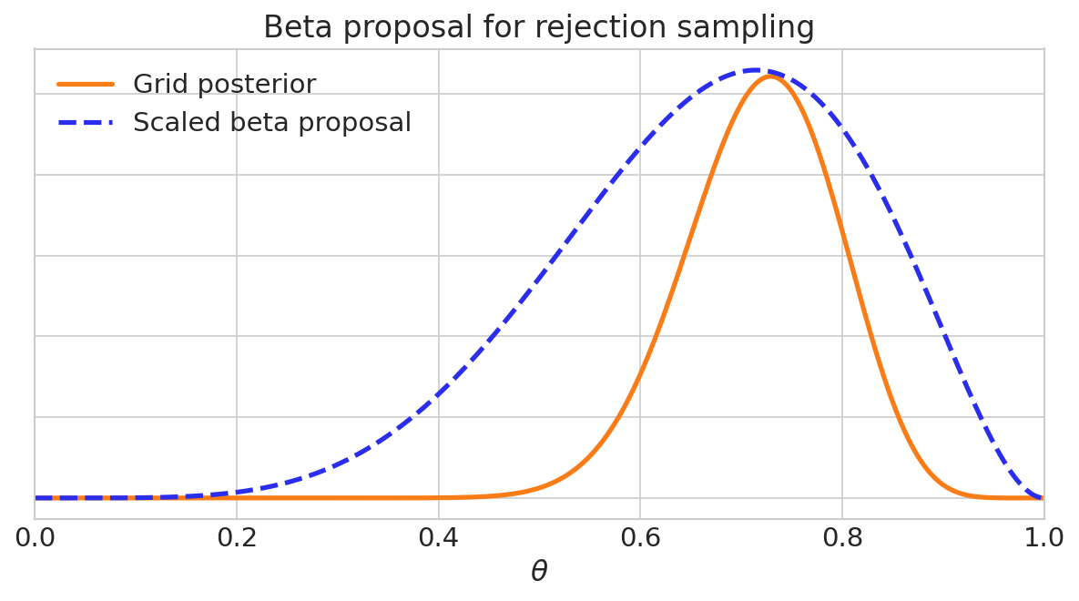
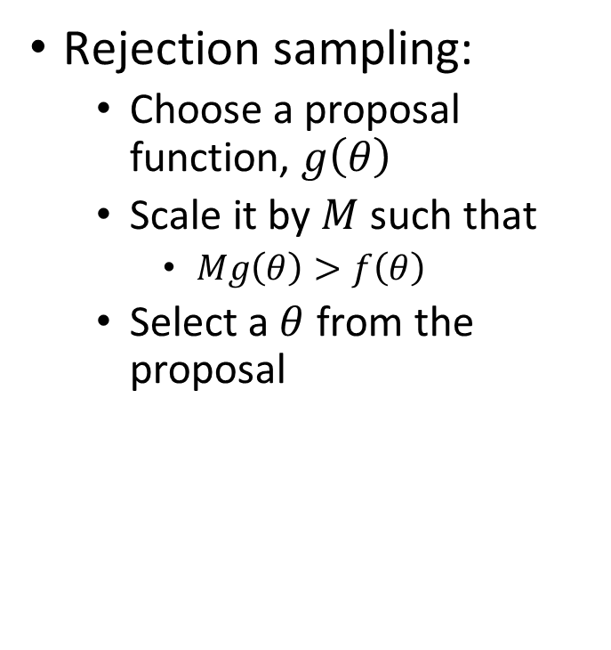
Rejection sampling samples a proposal function
Rejection sampling:
Choose a proposal function, $g\left(θ\right)$
Scale it by $M$ such that
$Mg\left(θ\right)>f\left(θ\right)$
Select a $θ$ from the proposal

Slide 12
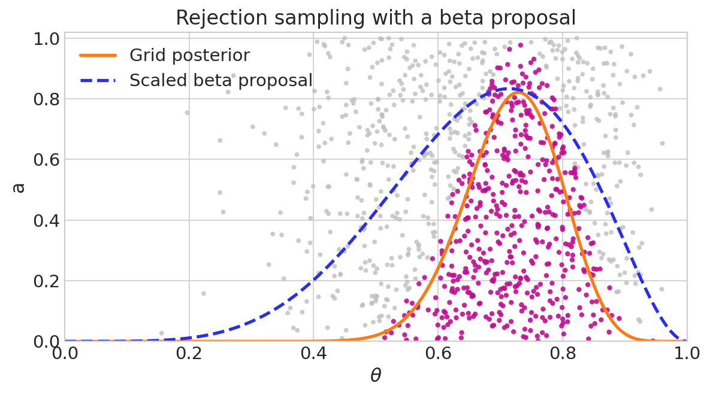
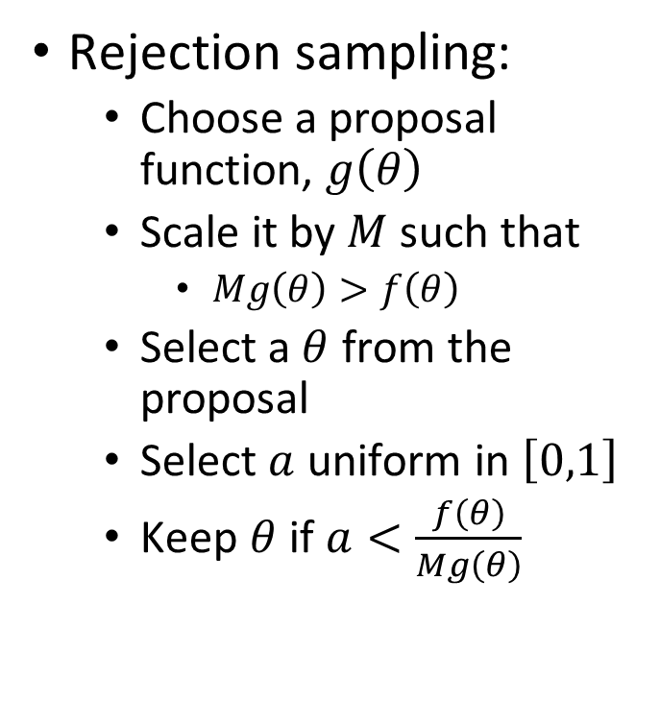
Rejection balances the desired and sampled probabilities
Rejection sampling:
Choose a proposal function, $g\left(θ\right)$
Scale it by $M$ such that
$Mg\left(θ\right)>f\left(θ\right)$
Select a $θ$ from the proposal
Select $a$ uniform in $\left[0,1\right]$
Keep $θ$ if $a<\frac{f\left(θ\right)}{Mg\left(θ\right)}$

Slide 13
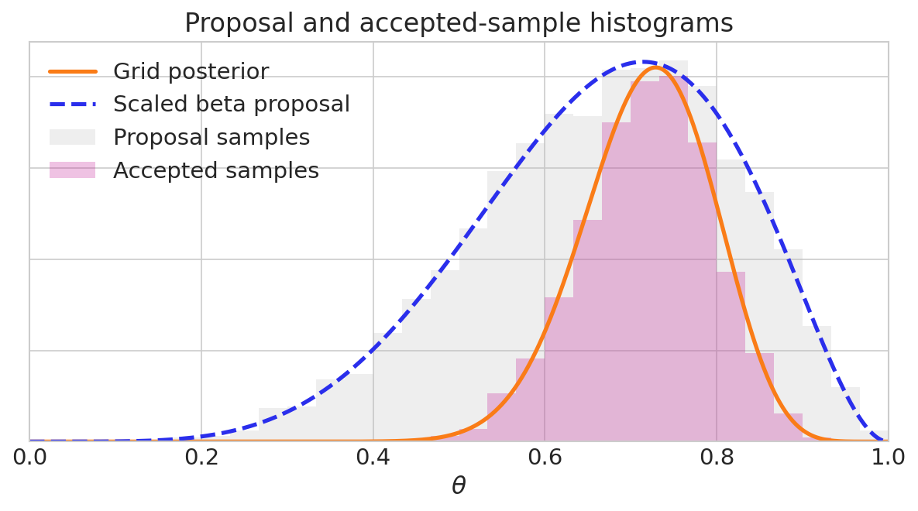
The advantages and challenges of rejection sampling
Broad range of distributions
Simple algorithm
Samples are independent
Finding and fitting the proposal function
Sensitive to shape of proposal function
Inefficient
Proposed samples | 10,000
Accepted samples | 4,823
Acceptance rate | 48%

Slide 14
4.3 Monte-Carlo Markov Chain
An iterative algorithm for sampling

Slide 15
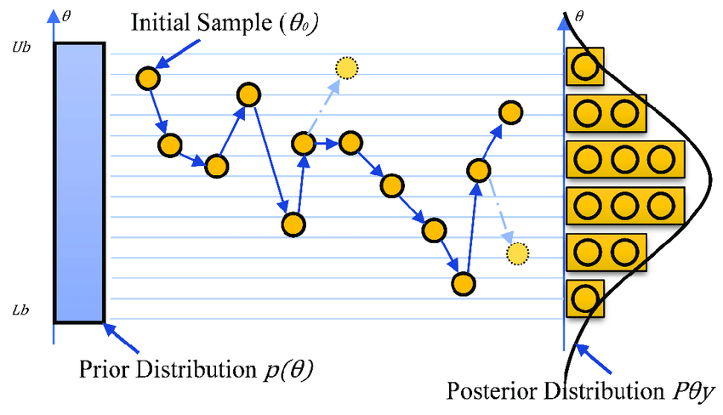
MCMC turns rejection sampling to a local walk
Use local proposals
Centered on the last sample
Easier to find
Easier to fit
Increase acceptance rate
But samples are no longer independent

Slide 16
MCMC works only when each chain explores the full posterior
Mathematical conditions for correctness:
Posterior must be finite (normalizable)
Support of the posterior should be connected (avoiding isolated regions)
Practical considerations:
Samples are not independent.
Must discard warm-up (burn-in) samples.
Requires careful checks to ensure the algorithm has converged.
Efficiency depends on model complexity and sampler settings.

Slide 17
4.4 Metropolis
The simplest MCMC algorithm

Slide 18


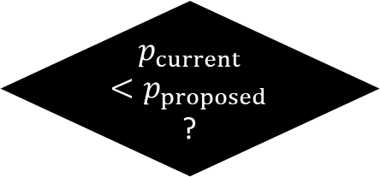

Metropolis builds samples one step at a time
Sample from $p\left(θ\right)$ starting at $θ_{\text{current}}$ which has probability $p\left(θ_{\text{current}}\right)=p_{\text{current}}$
Consider a next step to $θ_{\text{proposed}}$ which as probability $p\left(θ_{\text{proposed}}\right)=p_{\text{proposed}}$
Yes
Go to
$$θ_{proposed}$$
Next place:
$$θ_{proposed}, p_{proposed}$$
$p_{current}<p_{proposed}$?
Start somewhere
$$θ_{current}, p_{current}$$

Slide 19

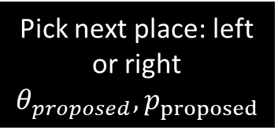
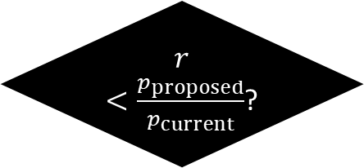
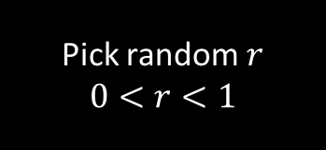

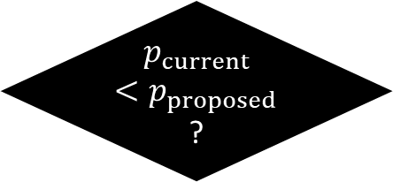
Metropolis sometimes accepts low probability moves
Yes
Go to
$$θ_{proposed}$$
Pick next place: left or right
$$θ_{proposed}, p_{proposed}$$
$p_{current}<p_{proposed}$?
Yes
No
Pick random $r$
$$0<r<1$$
$r<\frac{p_{proposed}}{p_{current}}$?
No
Go to
$$θ_{current}$$

Slide 20

A simple target distribution to clarify metropolis
Sample from a discrete distribution
7 possibilities: 1, 2, 3, 4, 5, 6, 7
$p\left(θ\right)∝θ$
We will not need the normalized probability
Start at $θ=4$

Slide 21
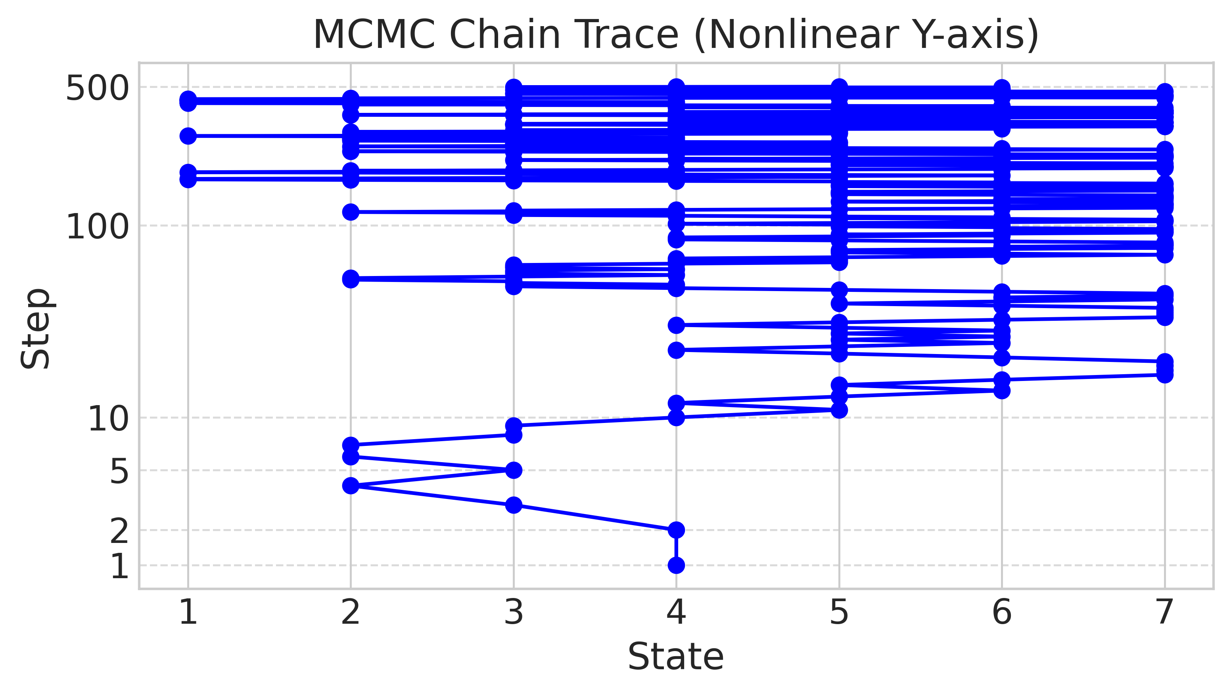
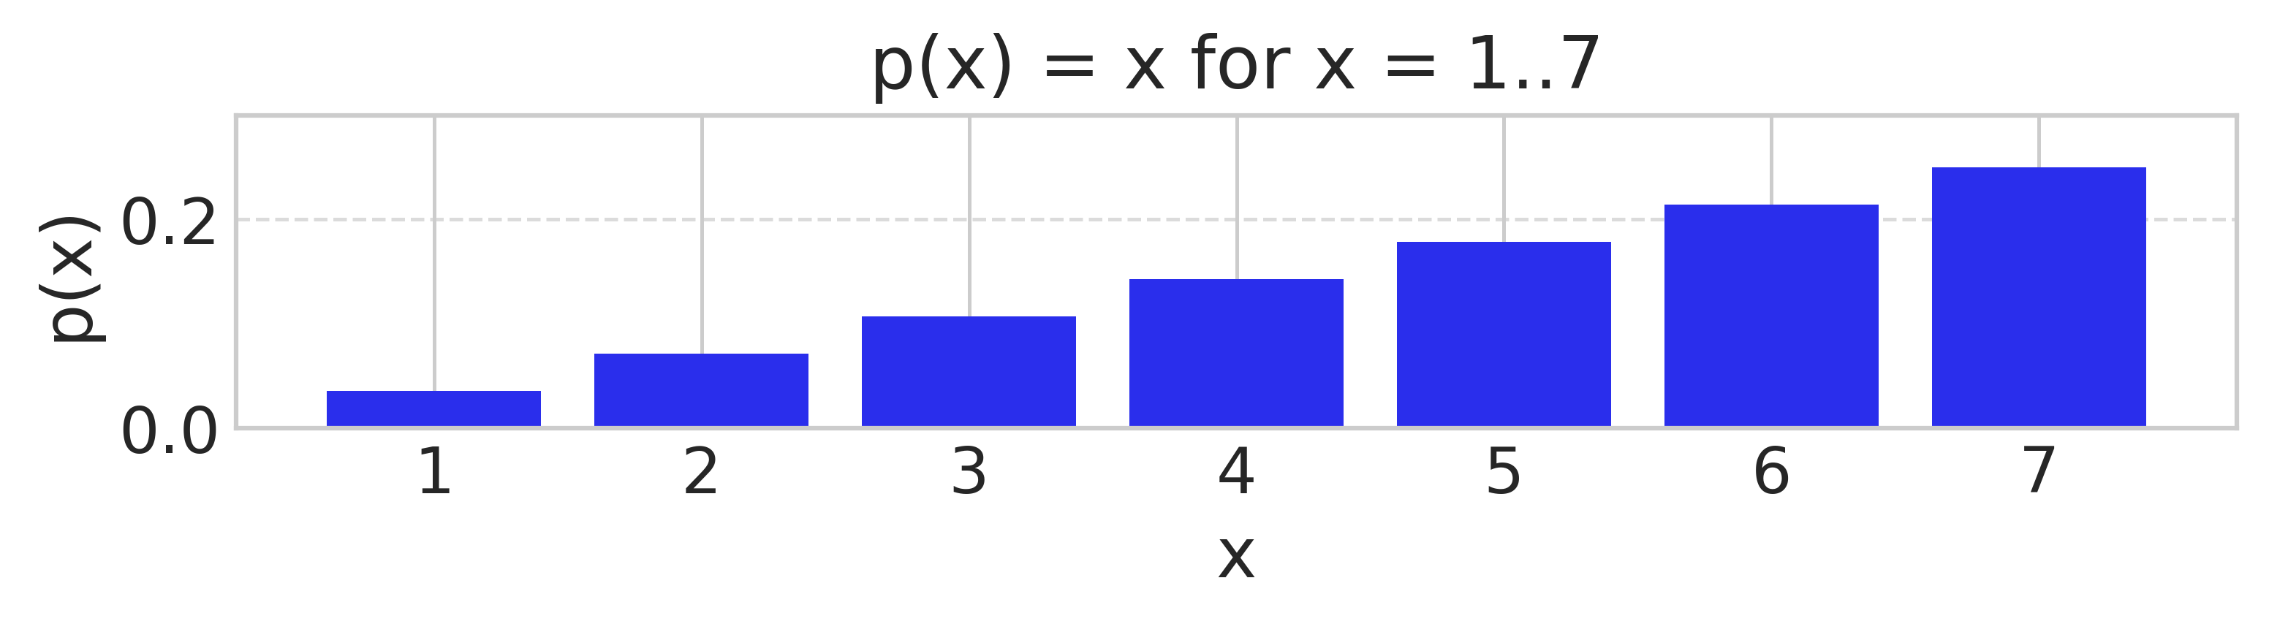
Metropolis run showing accept reject and stay
Step 1: left, r > 0.75, stay
Step 2: left, r < 0.75, go
Step 3: left, r < 0.66, go
Step 4: right, go
Step 5: left, r < 0.66, go
Step 6: left, r > 0.5, stay
Step 7: right, go
Step 8: left, r < 0.66, stay

Slide 22
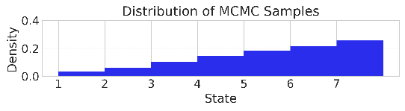

The chain spends more time in more probabile states
Which ends up picking each possibility with exactly its probability

Slide 23
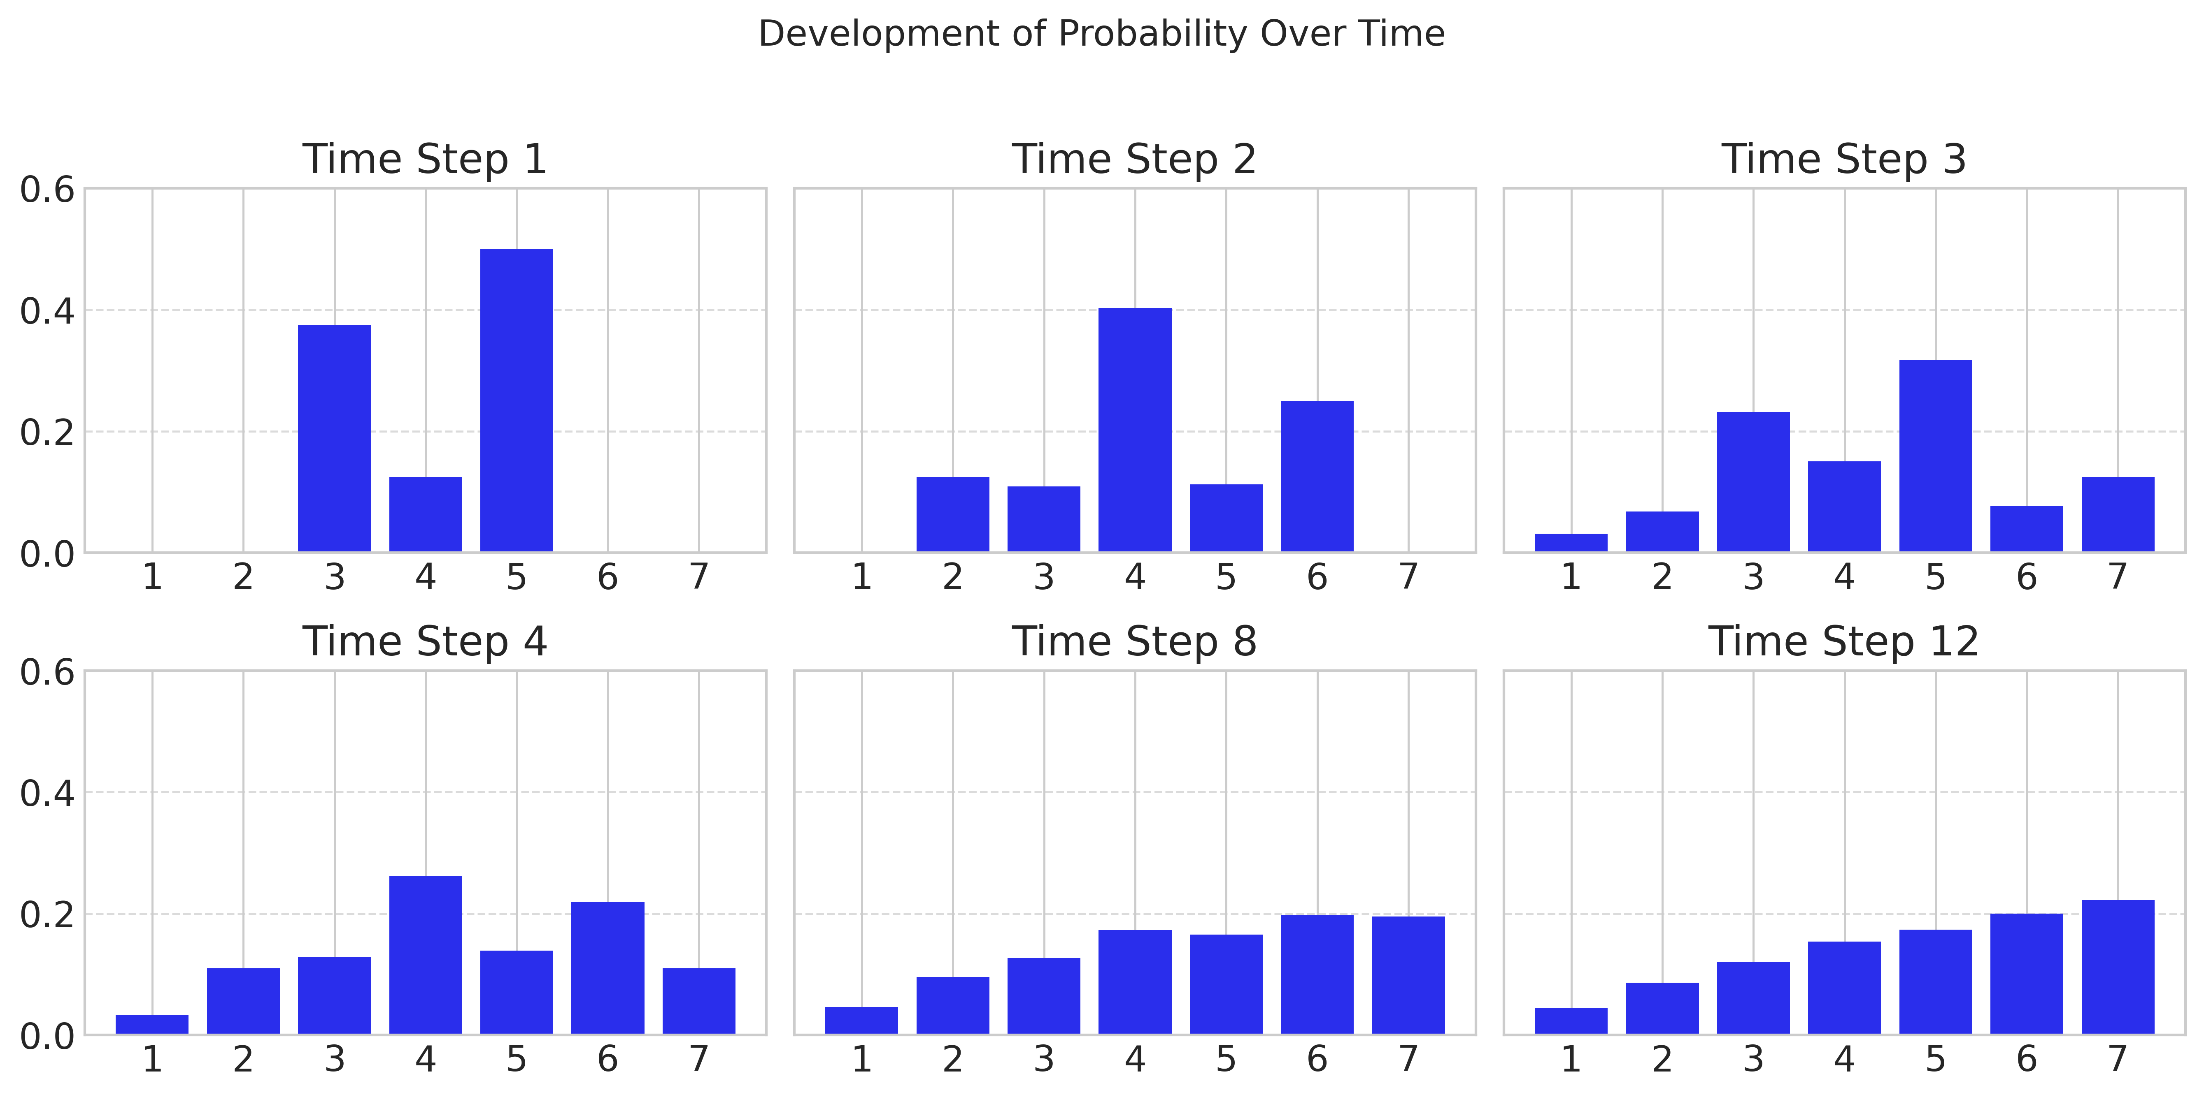
Empirical distribution quickly leaves initial condition

Slide 24
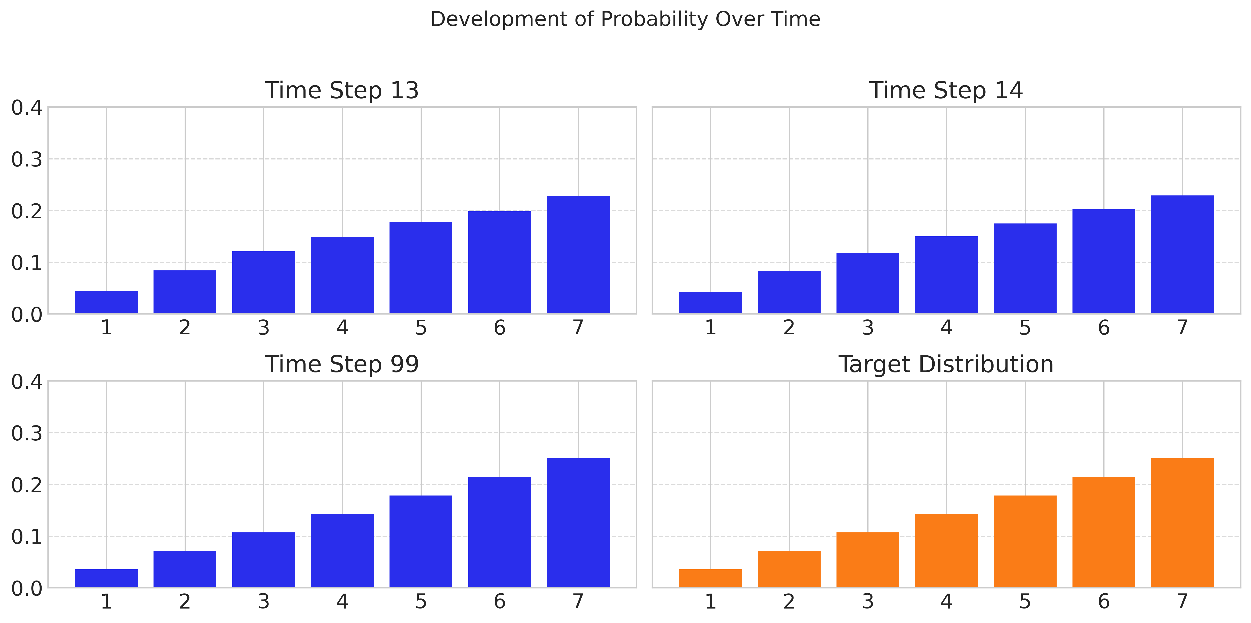
Empirical distribution slowly approaches target distribution

Slide 25
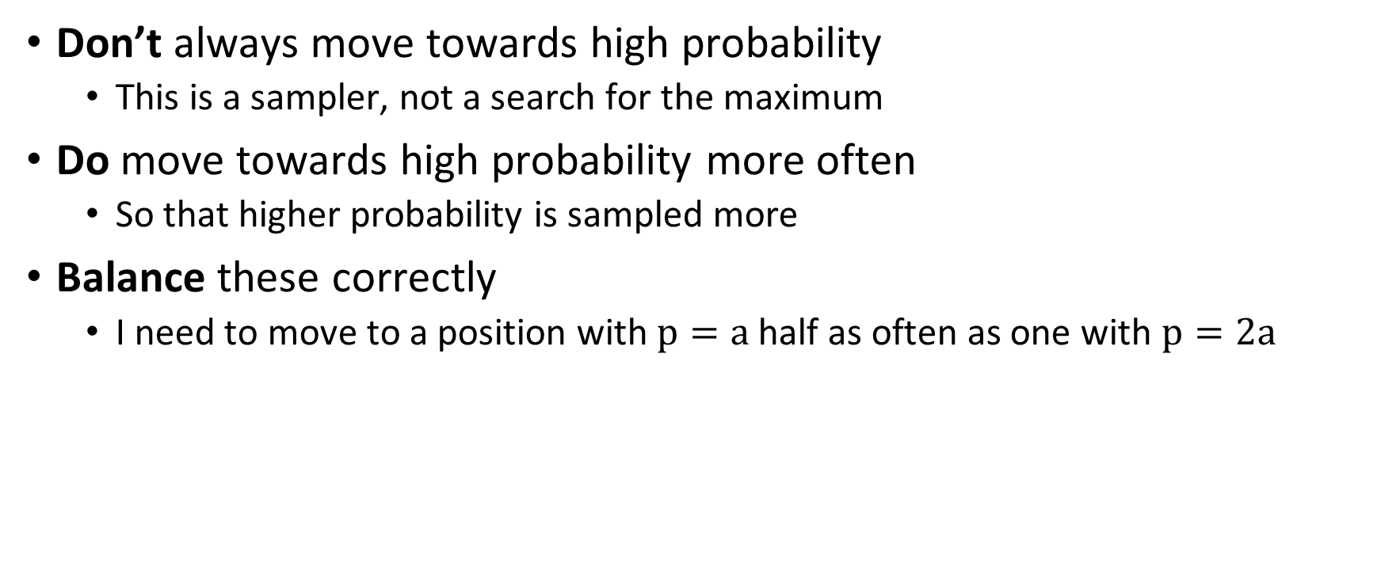
The intuition behind Metropolis
Don’t always move towards high probability
This is a sampler, not a search for the maximum
Do move towards high probability more often
So that higher probability is sampled more
Balance these correctly
I need to move to a position with $p=a$ half as often as one with $p=2a$

Slide 26
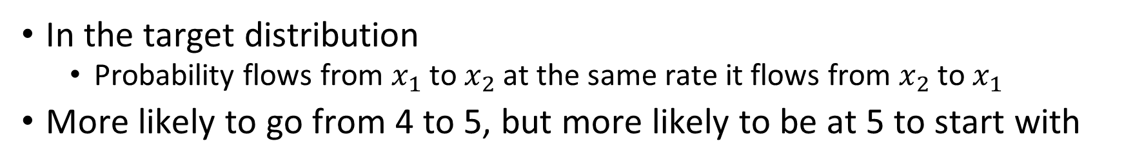

Detailed balance: probability flow in both directions
In the target distribution
Probability flows from $x_{1}$ to $x_{2}$ at the same rate it flows from $x_{2}$ to $x_{1}$
More likely to go from 4 to 5, but more likely to be at 5 to start with
In the example ($p\left(θ\right)∝θ$):

Slide 27
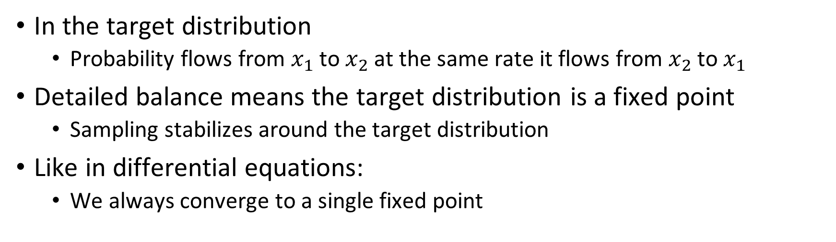
Detailed balance makes the target distribution stable
In the target distribution
Probability flows from $x_{1}$ to $x_{2}$ at the same rate it flows from $x_{2}$ to $x_{1}$
Detailed balance means the target distribution is a fixed point
Sampling stabilizes around the target distribution
Like in differential equations:
We always converge to a single fixed point

Slide 28

Metropolis rule only requires probability ratios
Note the trick of using $min$ instead of an $if$
If we don’t follow the proposal, we stay in the same place
The proposal function:
The target distribution:
The acceptance probability:
The update:

Slide 29
Metropolis-Hastings corrects asymmetric proposals
Adjust acceptance probability for the proposal asymmetry
Maintain detailed balance
The proposal function:
The acceptance probability:
The update:

Slide 30
Demo: Metropolis with good and narrow proposals
Good proposal
Narrow proposal

Slide 31
4.5 Sampling diagnostics
Trace plots, Rhat, ESS, and MCSE

Slide 32
Diagnostics test whether sampling succeeded
Diagnostics
Data
Model
Sample
Posterior
Inference
This doesn’t mean the model makes sense or fits the data
Only that we approximately sampled the posterior of our model

Slide 33
Diagnostics check sampling not the model
Did we succeed in sampling the posterior distribution?
Not assessing:
The model
The fit
The interpretation
Only asking
If the sampling algorithm worked
Two major criteria
Mixing of chains
Independence of samples

Slide 34
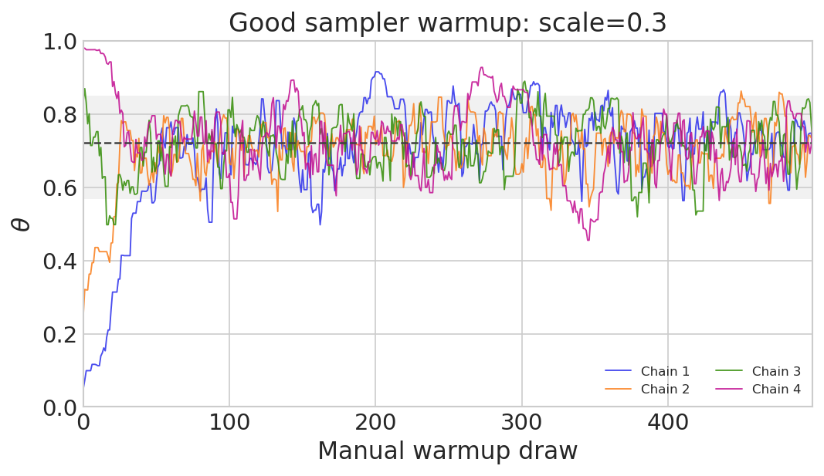
Multiple chains test how well we explored
Important for:
Exploring posterior
Convergence diagnostics
Parallelization
Each one will have a different starting point
Starting points should be “reasonable”
Otherwise convergence can take a long time

Slide 35
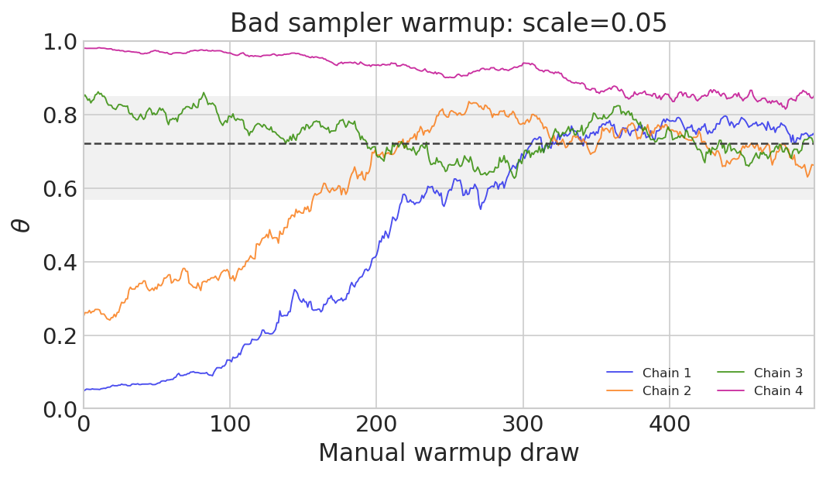
Poor tuning interferes with sampling
Proposal width unmatched to posterior width
Slow movement through the posterior
Long warmup to get past initial starting point
PyMC automatically
Chooses warmup
Uses warmup to tune sampling
Discards warmup

Slide 36
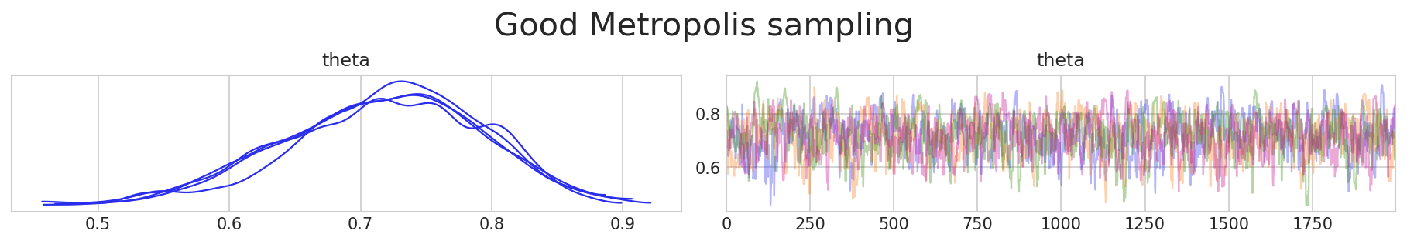
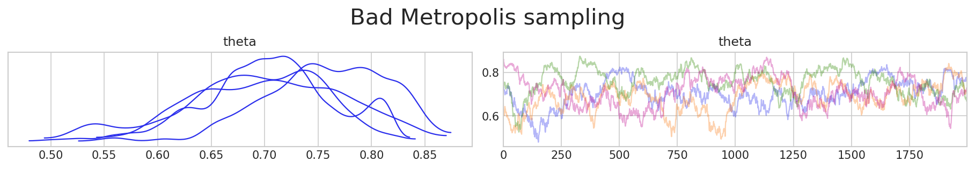
Trace plots reveal mixing and stuck chains
ax = az.plot_trace(idata, var_names=[‘theta’], chain_prop={"ls": "-"}, compact=False)
- “Stuck” sampling
- Lack of overlap

Slide 37
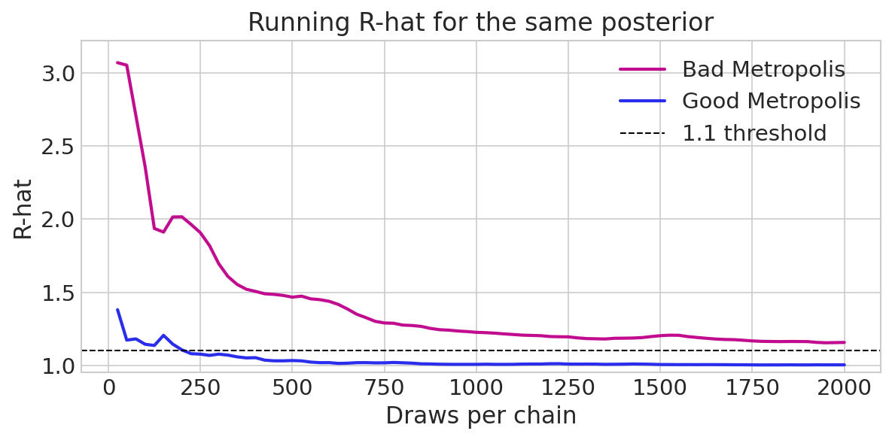
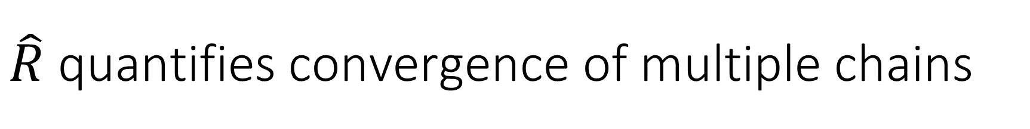
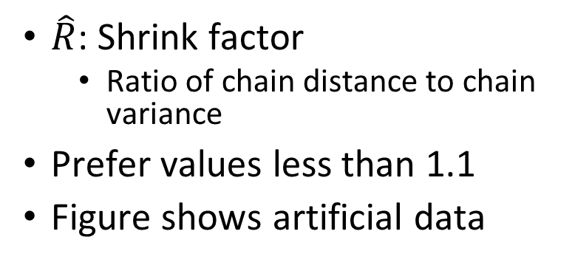
$\hat{R}$ quantifies convergence of multiple chains
$\hat{R}$: Shrink factor
Ratio of chain distance to chain variance
Prefer values less than 1.1
Figure shows artificial data
rhat = az.rhat(idata)
rhat.x.values

Slide 38
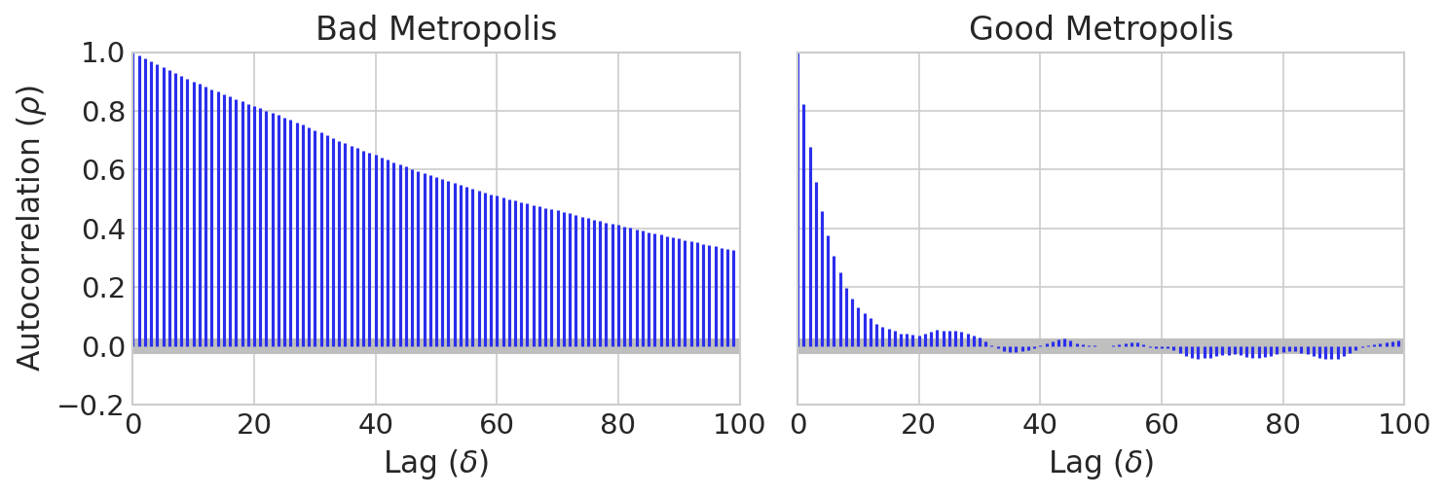
Autocorrelation measures redundancy of information
How much can you predict this sample from the previous samples?
How far away do you have to get to a truly independent sample

Slide 39
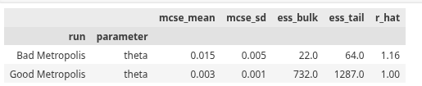
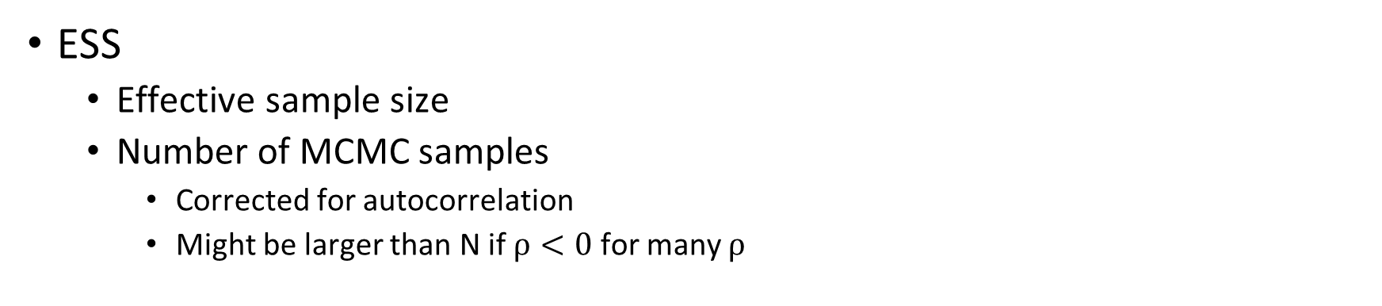
ESS shows how autocorrelation affects information
ESS
Effective sample size
Number of MCMC samples
Corrected for autocorrelation
Might be larger than N if $ρ<0$ for many $ρ$
bad_diagnostics = az.summary(idata_metropolis_bad, var_names=['theta'], kind='diagnostics')
good_diagnostics = az.summary(idata_metropolis_good, var_names=['theta'], kind='diagnostics')

Slide 40
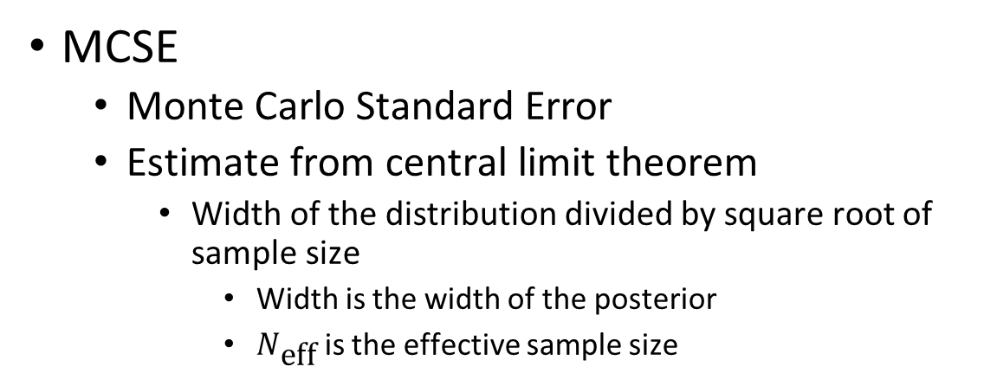
MCSE shows how autocorrelation affects uncertainty
MCSE
Monte Carlo Standard Error
Estimate from central limit theorem
Width of the distribution divided by square root of sample size
Width is the width of the posterior
$N_{\text{eff}}$ is the effective sample size

Slide 41
Diagnostics summary
First look
Trace plot
Look for:
Chain overlap
Consistent pattern of noise
Similar posteriors
Rhat
Measures overlap of chains
Should be less than 1.1
ESS
Measures within chain correlation
Gives information about how much information there is
Should be more than 500
MCSE
How well are we measuring the parameter
Should be less than 1-2%

Slide 42
4.6 HMC and NUTS
Typical sets, physical models, and gradients of the probability density, Hamiltonian Monte Carlo and No U-Turn Sampling

Slide 43
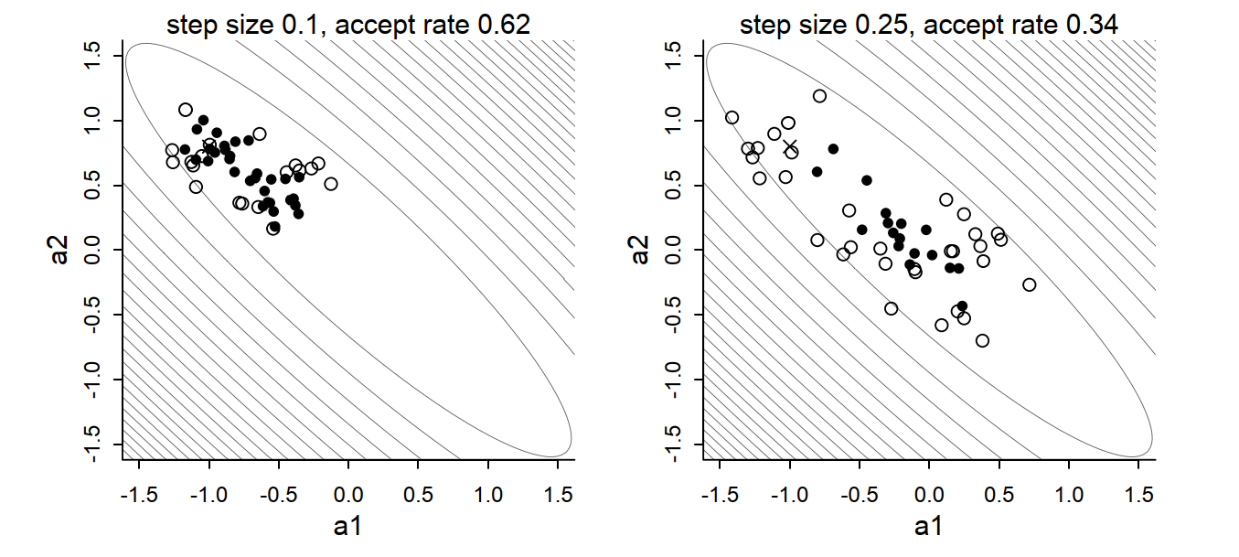
Metropolis proposals difficult for correlated parameters
As the dimensionality gets higher
The “good” jumps get harder to find
Parameter covariances get harder to esimate

Slide 44
Different MCMC algorithms balance simplicity and efficiency
Metropolis
Metropolis et al, 1953
Metropolis-Hastings
Metropolis with a non-symmetric proposal function
Hastings, 1970
Gibbs Sampling
Sample each parameter given the other parameters
Fewer rejections but more analytic work
Geman and Geman, 1984
Hamiltonian Monte Carlo (HMC)
Uses a complex physical model for a proposal function
Much more efficient
Duane et all, 1987
No U turn Sampler
Solves a serious problem in the HMC
Hoffman and Gelman, 2014

Slide 45
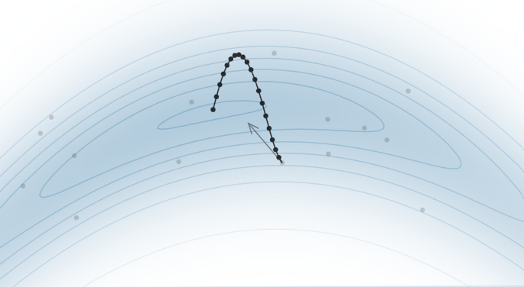
HMC uses gradients to shape proposals
HMC
Hamiltonian Monte Carlo
Use the gradient of the probability!
Every small step keeps is in “good” probabilities

Slide 46
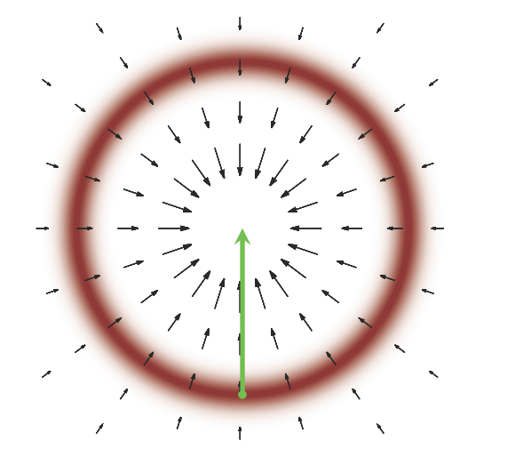
HMC is not a maximization algorithm
Many maximization algorithms use gradient descent
This finds an extreme point
Like maximum probability density
HMC doesn’t go up or down the gradient
Most of the probability is not at the mode

Slide 47
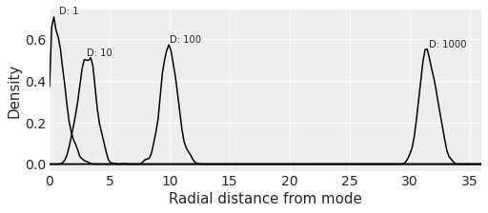
In high dimensions, probability is not at the mode
PDF of multi-dimensional gaussians
As a function of distance
def rad_dist(Y):
return np.sqrt(np.sum(Y**2))
xvar = np.linspace(0, 36, 200)
# the book code is wrapped in a loop to reproduce Figure 9.4
for D in [1, 10, 100, 1000]:
T = int(1e3)
Y = stats.multivariate_normal(np.zeros(D), np.identity(D)).rvs(T)
Rd = list(map(rad_dist, Y))
kde = stats.gaussian_kde(Rd)
yvar = kde(xvar)
ax.plot(xvar, yvar, color="k")
ax.text(np.mean(Rd), np.max(yvar) * 1.02, f"D: {D}")

Slide 48
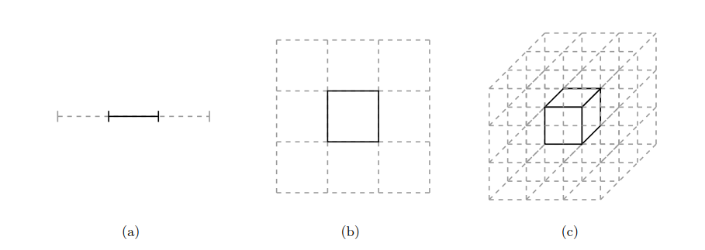
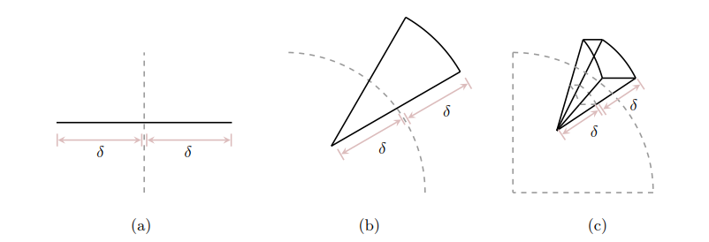
In high dimensions, the volume isn’t at the mode
Consider a N-D cube
What percentage is in the middle?
Consider a spherical shell
Let dimensionality increase
Look at exterior and interior volume

Slide 49
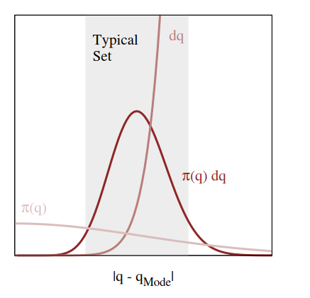

Probability mass combines density and volume
The typical set
Where most of the probability mass is
Not very close to the mode
Not very far from the mode
Visualization of a typical set in high dimensions

Slide 50

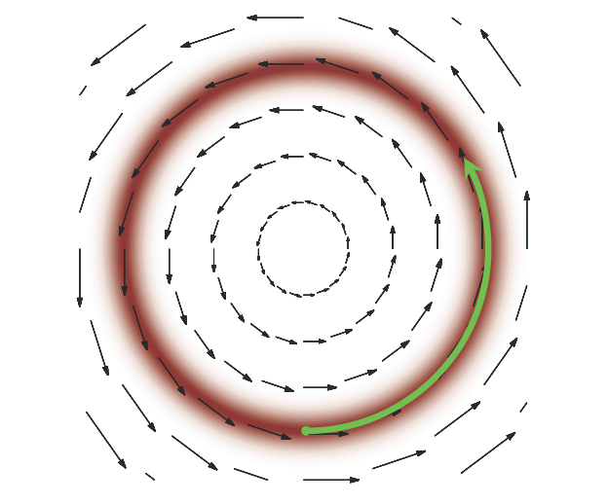
HMC proposals stay in the typical set
HMC moves perpendicular to the gradient
Like a satellite
Not towards the mode
Not away from it

Slide 51
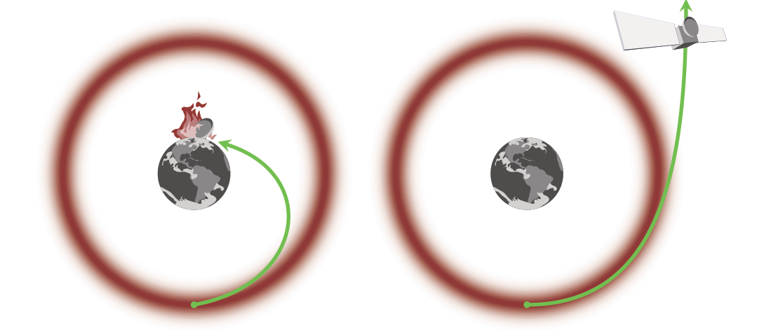
The right momentum keeps HMC in the typical set
Too little momentum and we end up near the mode
Too much momentum and we fly out into space

Slide 52
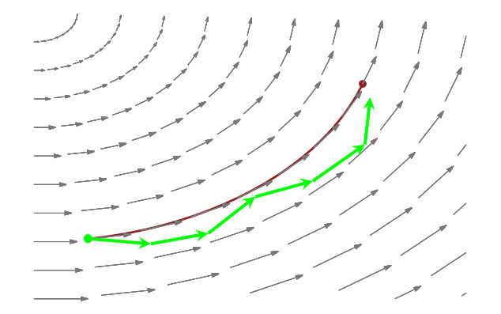
HMC must use simulated, approximated physics
Leapfrog integration
Half step in direction of momentum
Re-calculate momentum in new location
Repeat
This is just a proposal function
At the end apply Metropolis rule

Slide 53
HMC tuning balances approximation and computation time
Algorithm parameters:
Number of steps
Size of step
Tuning for:
Minimize correlation between samples
High target acceptance ratio
Default: 0.9

Slide 54
HMC is Metropolis with well tuned proposals
Special proposal function for Metropolis
Simulates physics to stay in the ‘typical set’
Goals
Minimize autocorrelation
Maintain very high acceptance ratio
Parameters
Number of steps
Step size
HMC

Slide 55
HMC can loop back on itself
HMC with u turns
The energy creates an orbit
Length of orbit is hard to guess

Slide 56
NUTS automates HMC path length selection
NUTS: No U-Turn Sampling
A variant of HMC
Explores multiple possible jumps in two direcitons
Default state-of-the-art sampler in PPCs
Parameters
Target acceptance probability
Controls step size
Higher gives slower but better sampling
Maximum tree depth
Controls the number of steps
Higher gives slower but better sampling
HMC with u turns

Slide 57
4.7 Divergences: HMC diagnostics
A diagnostic tool for failure of the HMC simulation

Slide 58
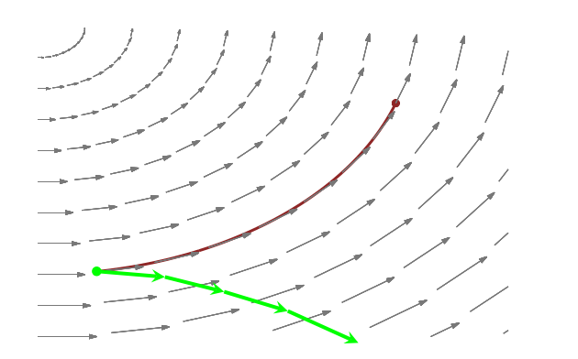
Divergences: failure of leapfrog integration
If probability is changing too quickly
Noise will compound and satellite “energy” will change
Depends on the step size and number of steps
Leads to change in ‘energy’

Slide 59
Divergences mean sampling is unreliable
Famous quote:
the rule of thumb is that divergences are nothing to worry about as long as you have fewer than about one of them.

Slide 60
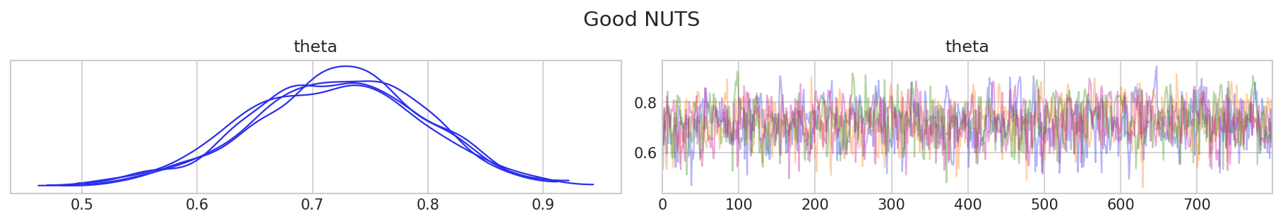
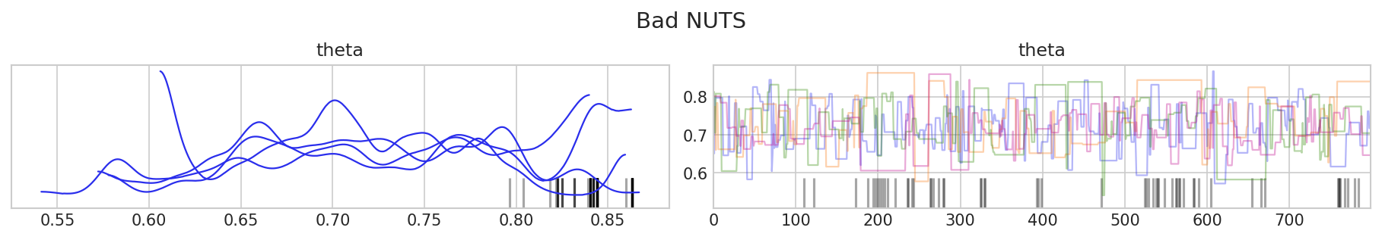
Trace plots show divergences
This can help identify the problematic region in parameter space

Slide 61
4.8 PyTensor
The machinery that translates models to math

Slide 62
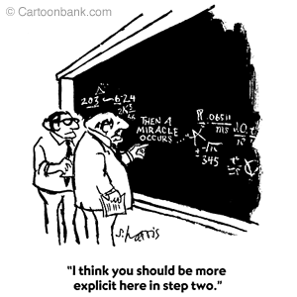
Where do gradients come from?
Start with a model and data
In PyMC
Call “sample”
Get samples
The algorithm uses:
Probability density
Gradients
Where do they come from?

Slide 63
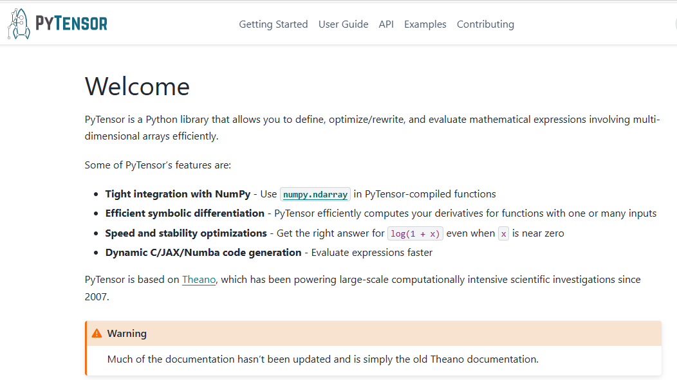
PyTensor is PyMC’s computational back end
HMC needs the log posterior density and its gradients
PyTensor computes them

Slide 64

Gradients tell PyMC how probability changes

Slide 65


PyMC symbolic variables become probability calculations
PyMC basic_RVs shows the random variables in our model
PyTensor dprint show the graph of relationships
type
size
parameters

Slide 66

PyTensor handles cascaded operations
Must draw theta in order to draw y

Slide 67

The log joint probability density function
PyMC uses PyTensor to create a function that gives the probability of parameters and data
And its gradient
sample_theta = pm.draw(theta_nonbeta)
theta_transformed = special.logit(sample_theta)
logp_func = nonconjugate_binomial_model.compile_logp()
dlogp_func = nonconjugate_binomial_model.compile_dlogp()
joint_logp = logp_func({"theta_interval__": theta_transformed})
gradient = dlogp_func({"theta_interval__": theta_transformed})
print(f"Sampled theta: {sample_theta:.6f}")
print(f"Observed y: {bernoulli_data}")
print(f"Joint log probability: {joint_logp:.6f}")
print(f"Gradient: {gradient}")
The PyMC model uses a transformed value of theta. Explained in future lecture.

Slide 68
4.9 Workflow validation
Prior predictive, diagnostics, and posterior predictive tests

Slide 69
Bayesian workflow is iterative and self-correcting
Diagnostics
Data
Model
Sample
Posterior
Inference
Posterior predictive sampling
Prior predictive sampling

Slide 70
Prior predictive checks test model coherence
Data
Model
Sample
Posterior
Inference
Prior predictive sampling

Slide 71
Predictive sampling selects parameters and data together
Given a model and priors
Repeat:
Select parameters from the priors
Pick data from the model given the parameters
A sanity check for model and priors
with nonconjugate_binomial_model:
idata_binomial_prior = pm.sample_prior_predictive(samples=1000, random_seed=42)

Slide 72

Prior predictive: what data is possible under the model?
Choose a set of parameters from the prior
Simulate data under these parameters

Slide 73




Inference data separates data, prior, and prior predictive
$$theta(chain, draw)$$
$$y(chain, draw,y_dim⁡_0)$$
$$y(y_dim⁡_0)$$

Slide 74
Diagnostics check sampling validity
Sampling validity
Diagnostics
Data
Model
Sample
Posterior
Inference
Prior predictive sampling
Model coherence

Slide 75
Diagnostics check sampling validity
Sampling validity
Diagnostics
Data
Model
Sample
Posterior
Inference
Prior predictive sampling
Model coherence

Slide 76
Posterior predictive tests test model fit
Sampling validity
Diagnostics
Data
Model
Sample
Posterior
Inference
Posterior predictive sampling
Prior predictive sampling
Model coherence
Model fit

Slide 77

Posterior predictive sampling is predictive sampling
Repeat:
Pick parameters from posterior distribution
Pick data from parameters

Slide 78


Posterior predictive samples are added to idata object
$$theta(chain, draw)$$
$$y(chain, draw,y_dim⁡_0)$$

Slide 79
Workflow development started in the first lecture
Step | Test | Solutions
Data collection | Data validation procedures | Improve methodology Develop protocols Document processes
Propose model | Generate graph Take sample | Test dimensions Debug
Sample prior predictive | Prior predictive plots | Simplify model Change priors
Sample posterior | Trace plots Rhat ESS MCSE Divergences | Improve sampling Change initialization Reparameterize model Simplify model Change priors
Sample posterior predictive | Posterior predictive plots Bayesian p values | Change model

Slide 80
The next two lectures introduced models
Step | Test | Solutions
Data collection | Data validation procedures | Improve methodology Develop protocols Document processes
Propose model | Generate graph Take samples | Test dimensions Debug
Sample prior predictive | Prior predictive plots | Simplify model Change priors
Sample posterior | Trace plots Rhat ESS MCSE Divergences | Improve sampling Change initialization Reparameterize model Simplify model Change priors
Sample posterior predictive | Posterior predictive plots Bayesian p values | Change model

Slide 81
This lecture introduced the key workflow tests
Step | Test | Solutions
Data collection | Data validation procedures | Improve methodology Develop protocols Document processes
Propose model | Generate graph Take samples | Test dimensions Debug
Sample prior predictive | Prior predictive plots | Simplify model Change priors
Sample posterior | Trace plots Rhat ESS MCSE Divergences | Improve sampling Change initialization Reparameterize model Simplify model Change priors
Sample posterior predictive | Posterior predictive plots Bayesian p values | Change model

Slide 82
Each failure mode has different solutions
Step | Test | Solutions
Data collection | Data validation procedures | Improve methodology Develop protocols Document processes
Propose model | Generate graph Take samples | Test dimensions Debug
Sample prior predictive | Prior predictive plots | Simplify model Change priors
Sample posterior | Trace plots Rhat ESS MCSE Divergences | Improve sampling Change initialization Reparameterize model Simplify model Change priors
Sample posterior predictive | Posterior predictive plots Bayesian p values | Change model

